Slide 1

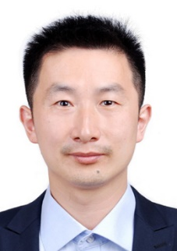

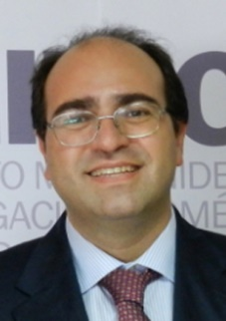
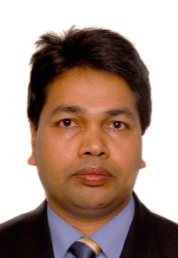
World Journal of Diabetes Editorial Board Meeting 2021
Jin-Lei Wang, General Manager November 9, 2021 Beijing 1 Introduction of World Journal of Diabetes 2 Submission and publications of World Journal of Diabetes 3 Publication process of manuscript 4 World Journal of Diabetes’s Editorial system - F6Publishing system 5 Editorial Board introduction 6 Invitation for World Journal of Diabetes in 2021 7 Open discussion
Editors-in-Chief
Jian-Bo Xiao, DPhil, PhD, Full Professor, Department of Analytical Chemistry and Food Science, Faculty of Food Science and Technology, University of Vigo, Vigo 36310, Spain
Lu Cai, MD, PhD, Professor, Department of Pediatrics, University of Louisville, Louisville, KY 40202, United States
Manfredi Rizzo, MD, PhD, Professor, Biomedical Department of Internal Medicine and Medical Specialties, University of Palermo, Palermo 90127, Italy
Md. Shahidul Islam, BSc, MSc, PhD, Professor, Department of Biochemistry, University of KwaZulu-Natal, Durban 4000, South Africa

Slide 2
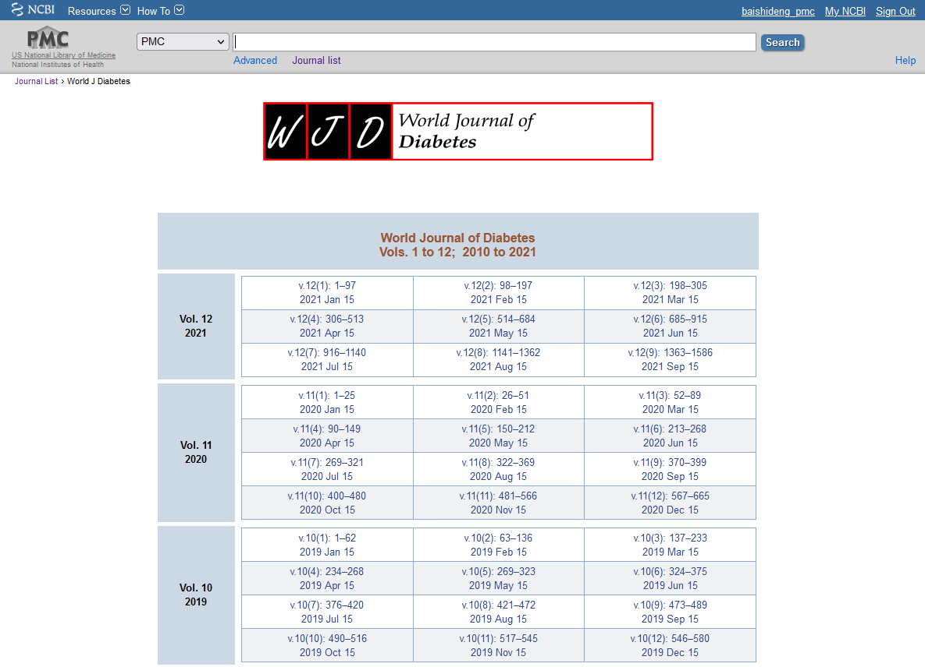
1 Introduction of World Journal of Diabetes
(1) Over view of the journal
The World Journal of Diabetes (WJD) is a high-quality, monthly, online, open-access, single-blind peer-reviewed journal. The WJD publishes articles based upon their academic quality, academic norms, academic ethics, and academic integrity, with an aim of disseminating academic research results to the world and leading the healthy development of the academic community. The WJD is now abstracted and indexed in Science Citation Index Expanded (SCIE, also known as SciSearch®), Journal Citation Reports/Science Edition, Current Contents®/Clinical Medicine, Scopus, PubMed, and PubMed Central.

Slide 3
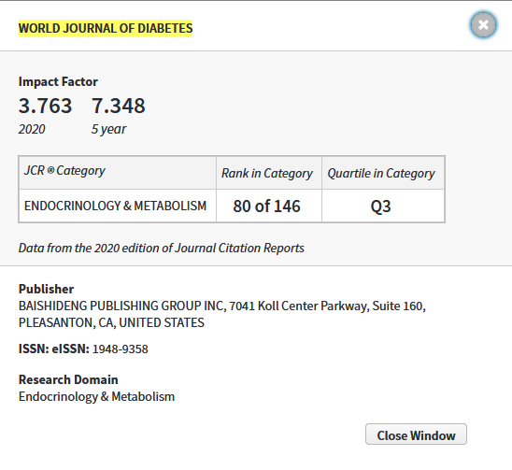
1 Introduction of World Journal of Diabetes
(2) Journal metrics
The 2021 Edition of Journal Citation Reports® cites the 2020 impact factor (IF) for WJD as 3.763; IF without journal self cites: 3.684; 5-year IF: 7.348; Journal Citation Indicator: 0.64; Ranking: 83 among 146 journals in endocrinology and metabolism; and Quartile category: Q3.

Slide 4
1 Introduction of World Journal of Diabetes
(3) Journal metrics
The WJD was included in SCIE in 2019. The WJD’s first IF is 3.247 and the IF without journal self cites is 3.222 in 2019. The IF in 2020 increased by 15.9% compared with the IF in 2019.

Slide 5
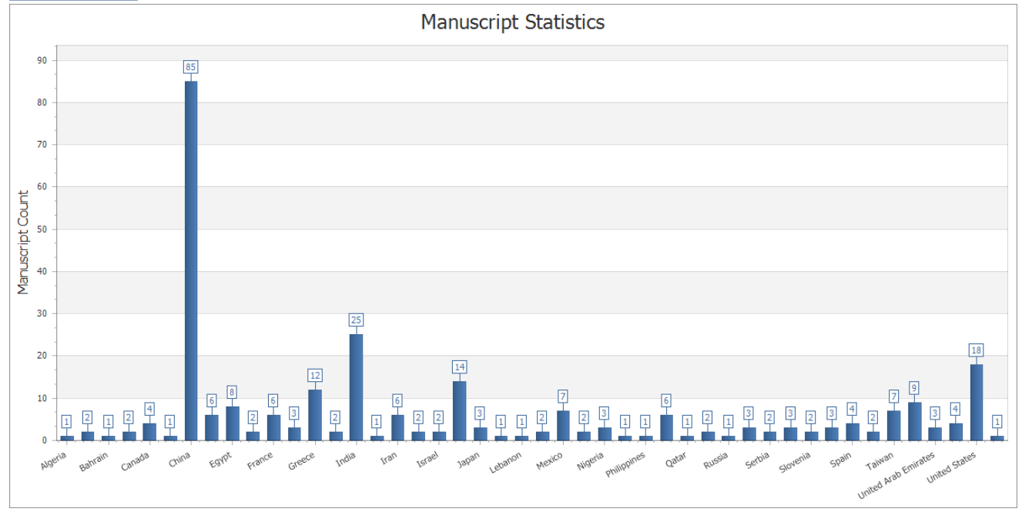
2 Submission and publications of WJD
(1) Number of submissions in recent years
From 2013 to 2021, the WJD has received a total of 1476 manuscripts, and the average number of submissions per year is 164. As of December 8, 2021, the WJD has received 287 manuscripts in this year, whose authors are from 46 countries/territories.

Slide 6
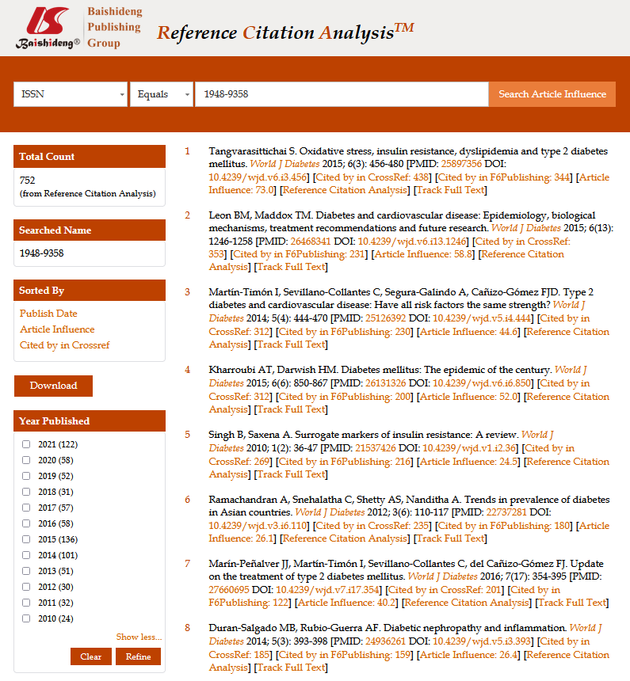
2 Submission and publications of WJD
(2) Number of published manuscripts during 2010-2021
Based on our recent developed “Reference Citation Analysis” system, the WJD has published 752 articles from its launch in 2010 to 2021. Of note, one article published in 2015 was cited 438 times.

Slide 7
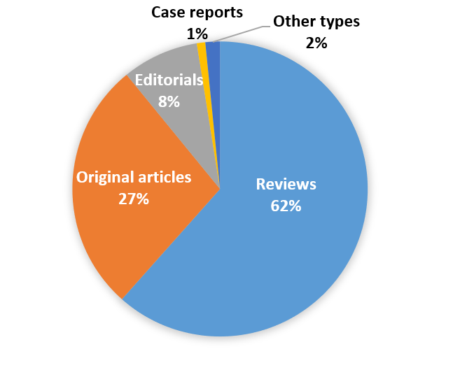
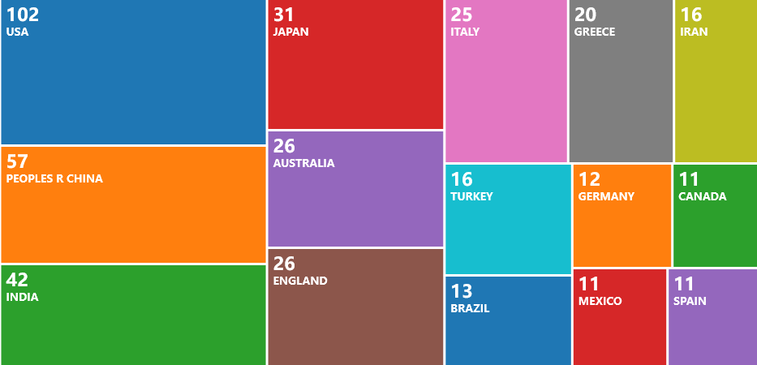
2 Submission and publications of WJD
(2) Number of published manuscripts during 2010-2021
The 752 articles published in WJD during 2010-2021 include 463 reviews, 207 original articles, 63 editorials, 7 case reports, and 12 articles of other types. As of December 8, 2021, 500 articles published in WJD are indexed in the Web of Science, whose authors are located in 51 countries/territories, including United States (102 articles, 20.4%), China (57 articles, 11.4%), India (42 articles, 8.4%), Japan (31 articles, 6.2%), Australia (26 articles, 5.2%), and United Kingdom (26 articles, 5.2%), etc.

Slide 8
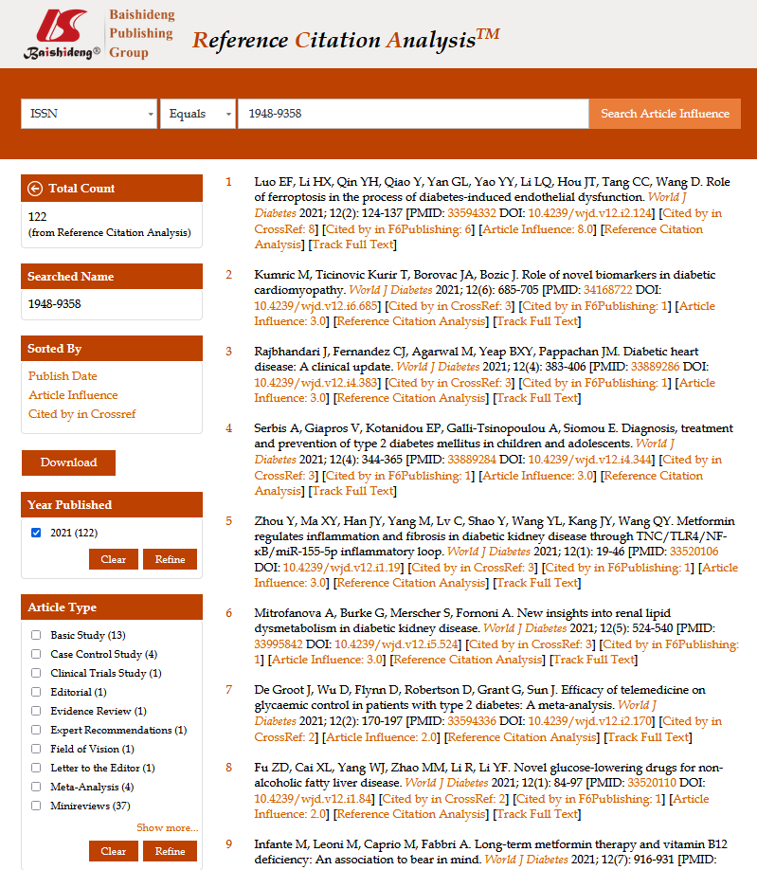
2 Submission and publications of WJD
(3) Number of published articles in 2021
As of December 8, 2021, the WJD has published 122 articles in this year. One article published on February 15, 2021 was cited 8 times in the current year.

Slide 9
2 Submission and publications of WJD
(4) Number of submission and publications during 2013-2021
Compared with number of submission and publications in 2020, the number of submission and publications increased by 117.4% and 110.3%, respectively in 2021.

Slide 10
3 Publication process of manuscript
The publication process of a manuscript is listed as follow: Manuscript reception and registration; Single blind externally peer review; First decision; Revision by the author(s); Second decision; Final review by the Editor-in-Chief; Final acceptance; Production; and Published online.
Manuscript reception and registration
Single blind externally peer review
First decision
Revision by the author(s)
Second decision
Final review by the Editor-in-Chief
Final acceptance
Production
Published online

Slide 11
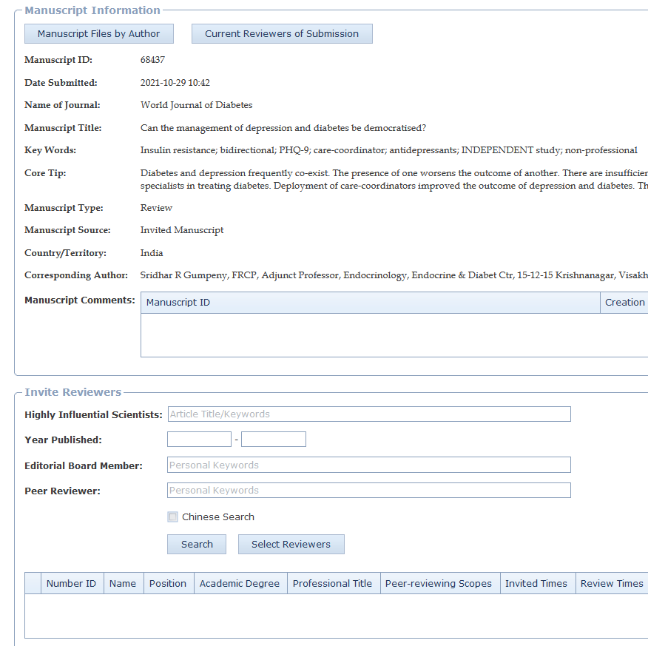
3 Publication process of manuscript
(1) Single blind externally peer review
The peer review model is single blind; however, the reviewer can choose to hidden or not hidden his/her name to the author. Both the invited and unsolicited manuscripts will be externally peer reviewed. Our artificial intelligence system automatically selects 20 external peer reviewers for each manuscript from our database of high-impact experts and scholars. At the same time, our science editor manually selects 10 Editorial Board Members in a single-blind manner to review the manuscript. Usually, the peer review process takes 7-14 days to complete. Before the formal peer review is initiated, peer reviewers should consider and answer the following two questions: (1) Does the manuscript have a conflict with your interests? (2) Does the research content of the manuscript meet the requirements of ethical norms?

Slide 12
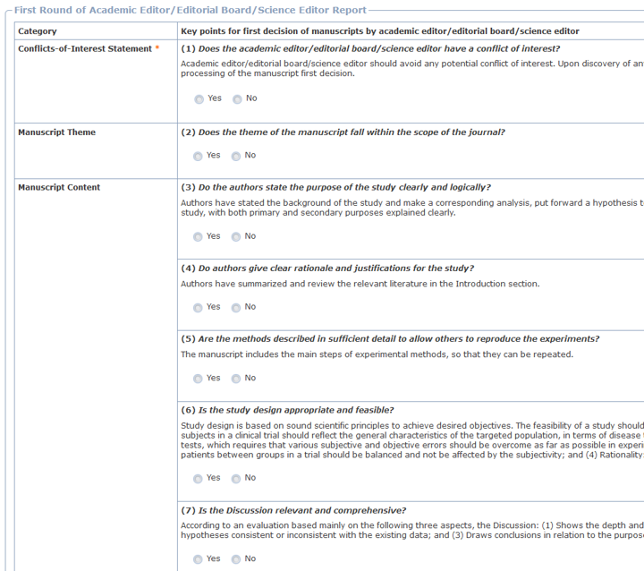
3 Publication process of manuscript
(2) First decision by Academic Editor/Editorial Board/Science Editor
After the manuscript was peer reviewed by the peer reviewer(s) and/or editorial board member(s), we will invite the Academic Editor/Editorial Board/Science Editor to make the first decision for the manuscript and write an evaluation report of this first decision. The main task of the first decision is to verify and evaluate the academic quality of manuscripts based on the peer-review report and key points for first decision of manuscripts. Academic editors will independently decide to accept or reject the manuscript or suggest to the authors a transfer of the manuscript to another of our journals. Currently, the WJD has 8 online Academic Editors.

Slide 13
3 Publication process of manuscript
(3) Second decision by Company Editor-in-Chief
After the authors revised the manuscript in accordance with the peer-review report and the criteria for manuscript revision, and responded to the issues raised in the peer review report, the revised manuscript will be edited by the science editor according to the journal’s guidelines. Then the Company Editor-in-Chief will make the second decision for the manuscript based on the peer review report of the manuscript, manuscript information, manuscript-related documents, and Science Editor/Online Academic Editor's evaluation report, and write an evaluation report on the acceptance or rejection of the manuscript.
Authors revise the manuscript
Science Editor edits the manuscript
Company Editor-in-Chief makes the second decision

Slide 14
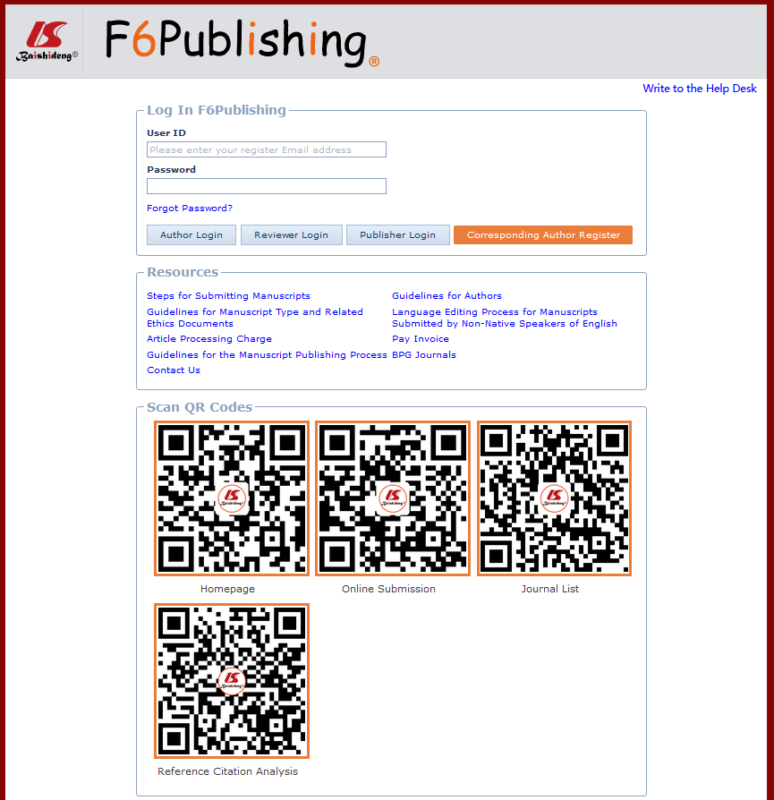
4 WJD’s Editorial system - F6Publishing system
F6Publishing is an artificial intelligence-based system that integrates the functions of online manuscript submission, peer review, manuscript revision by authors, manuscript production, manuscript publishing and release, editing and publishing management, and statistics of publishing fees and costs.

Slide 15
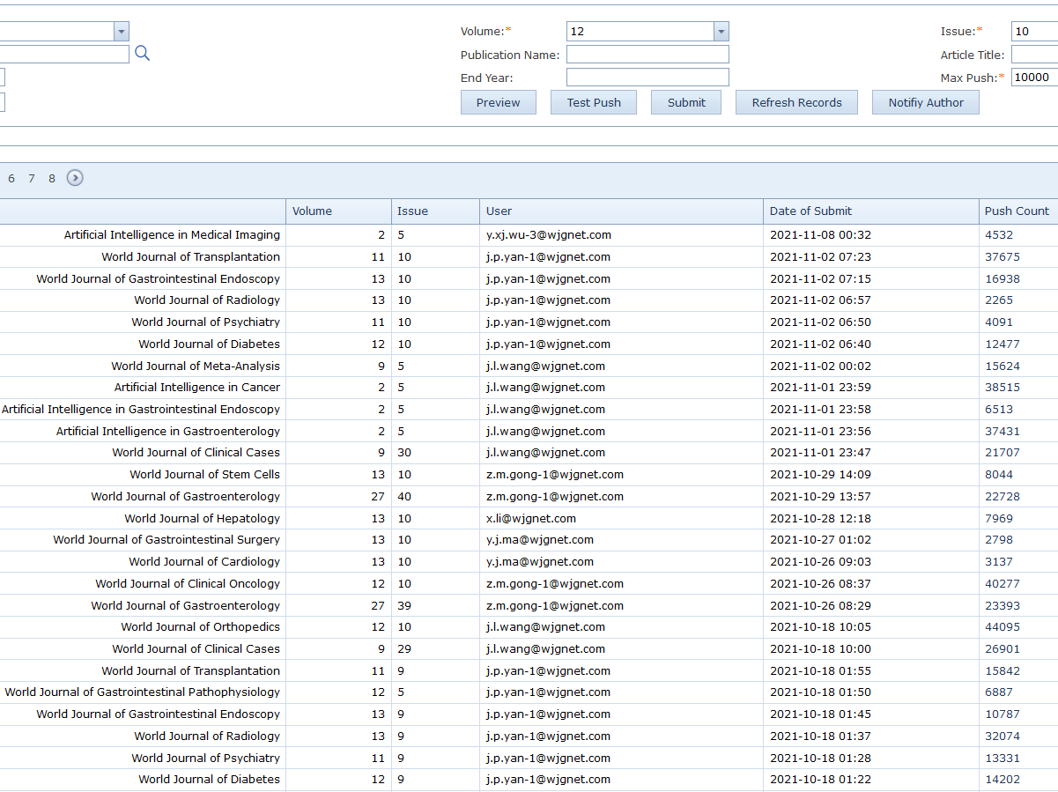
4 WJD’s Editorial system - F6Publishing system
(1) Maximize article impact for authors
To enable more peers to read, share, and cite authors’ published research results, to help enhance authors’ global academic influence, and to promote the overall development of the field, Baishideng accurately send published articles to highly influential 1000-10000 experts. And after completing this, Baishideng will formally notify authors of the number of experts to whom their manuscript is sent via email.

Slide 16
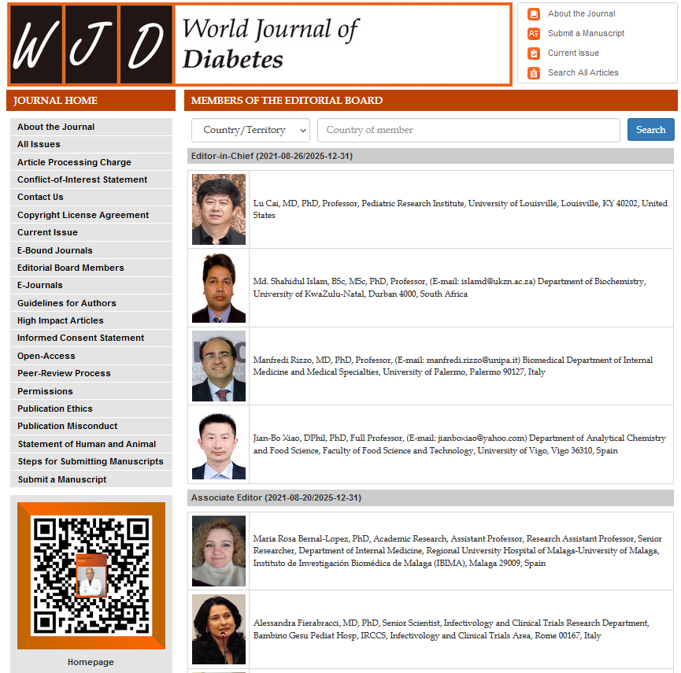
5 Editorial Board introduction
The 2021 Editorial Board of WJD is composed of 101 Editorial Board Members. They are from 35 countries or regions, including 20 (19.8%) in China, 10 (9.9%) in United States, 8 (7.9%) in Italy, 6 (5.9%) in India, 5 (5.0%) in Greece and 52 (51.5%) in other countries or regions.

Slide 17
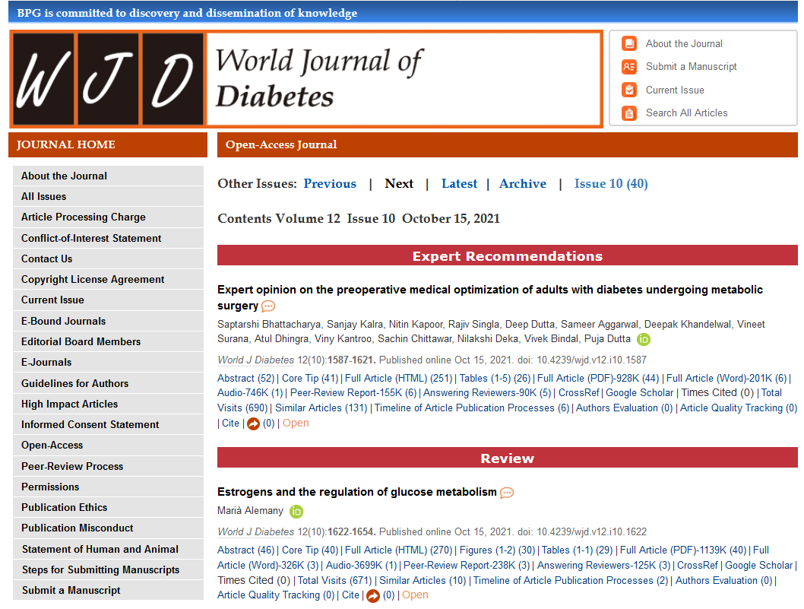
5 Editorial Board introduction
(1) Responsibilities of Editors-in-Chief and Associate Editors
In addition to the responsibilities of the Editorial Board members, the Editors-in-Chief and Associate Editors of the WJD mainly participate in the first decision making and the final reviewing of manuscripts. However, our practical practice indicate that the result is not satisfied. Next, we will continue to communicate with the Editors-in-Chief and Associate Editors to see if they are interested in making the first decision and final review of the manuscripts.

Slide 18


5 Editorial Board introduction
(2) Responsibilities of Editorial Board Members
Conducting peer review of at least six manuscripts each year. Reviewing the academic and language quality of manuscripts to ensure the academic level of journals. Conducting the manuscript peer-review task timely and carefully. Making a fair and objective evaluation to manuscripts, and giving detailed reasons for accept/reject a manuscript and detailed comments of revision. Willingness to track the post-publication evaluations on the manuscripts you reviewed.

Slide 19


5 Editorial Board introduction
(2) Responsibilities of Editorial Board Members
Willingness to organize a special topic, by inviting 7-10 manuscripts from experts and scholars in the field to contribute manuscripts on a hot topic. Recommending high-quality manuscripts for submission to the journal. Promoting published articles, including through use of personal social media to forward the articles published in the journal and share them with more colleagues. Recommending distinguished experts and scholars in the field to join the Editorial Board as new members.

Slide 20
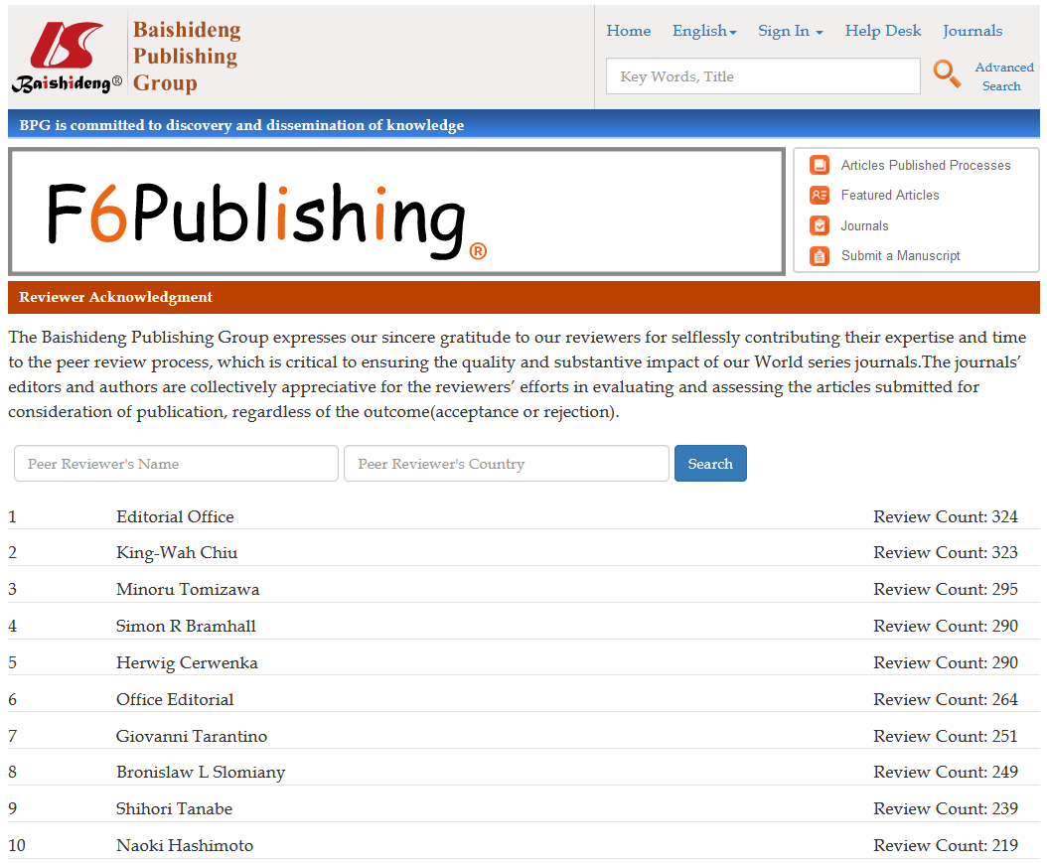
5 Editorial Board introduction
(3) Privileges of Editorial Board Members
Regular invitations to contribute editorials and review articles for the journal, for which the publication fee will be waived. A 10% discount of the publishing fee for other articles submitted by the member. A listing of personal professional information on the journal’s homepage. Public acknowledgement of related contributions to the journal, by posting of the member’s name and number of manuscripts he/she reviewed on the journal’s website. For details, please visit: https://www.f6publishing.com/HighlyInfluentialPeerReviewers. Selection of outstanding members of the Editorial Board to appear as the cover figures published on the cover page of each issue.

Slide 21
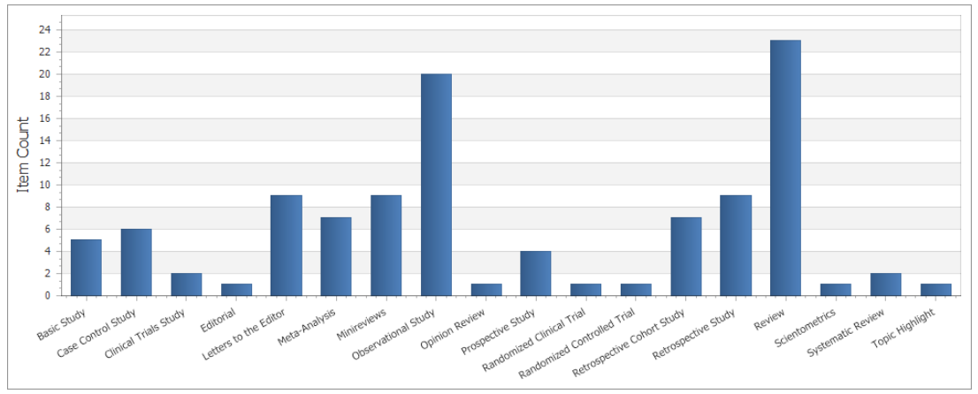
6 Invitation for manuscripts for WJD in 2021
As of November 8, 2021, the WJD has received a total of 109 titles of invited manuscripts, including 43 (39.4%) review articles, 56 (51.4%) original articles, and 10 (9.2%) other types of articles. In December 2021, we plan to continue to invite global experts and scholars in the field of diabetes to write high-quality reviews, original articles, and special issue articles for the WJD in 2022.

Slide 22
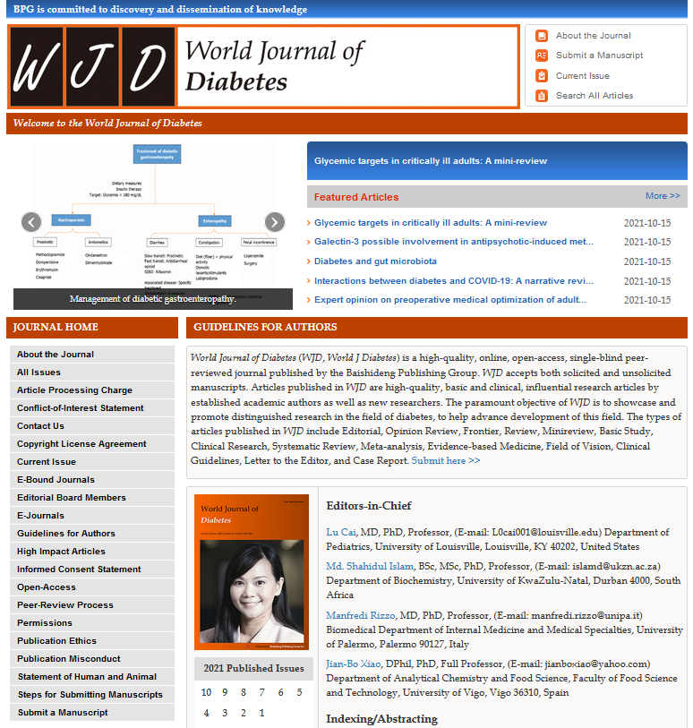
7 Open discussion
Meeting with Associate Editors and Editorial Board Members Frequency of meeting with journal office/publisher Development of special issues Improving the citation and impact factor of journal Future plan to organize conference

Slide 23
World Journal of Diabetes Editorial Board Meeting 2021
Thank you very much!
Na Ma, MSc, Intermediate Editor, Office
Jin-Lei Wang, MSc, Intermediate Editor, Office
Jia-Ping Yan, MSc, Intermediate Editor, Science Editor Development Department

